Slide 1




APSSDC
Andhra Pradesh State Skill Development Corporation
(Department of Skills Development and Training, Govt of Andhra Pradesh)
Web Development with Django
dj
django

Slide 2
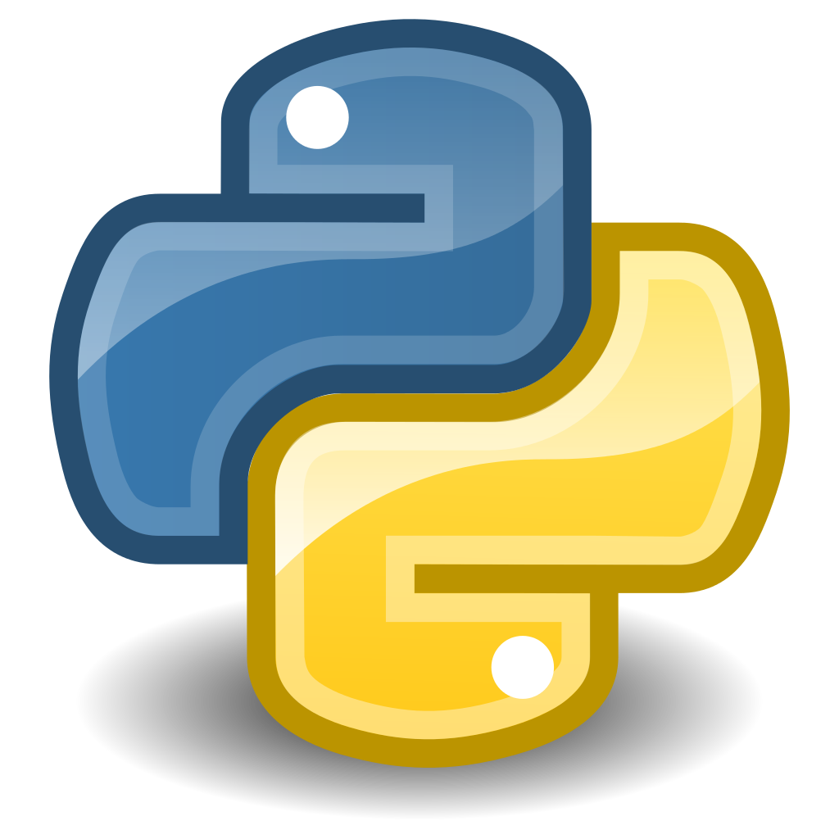
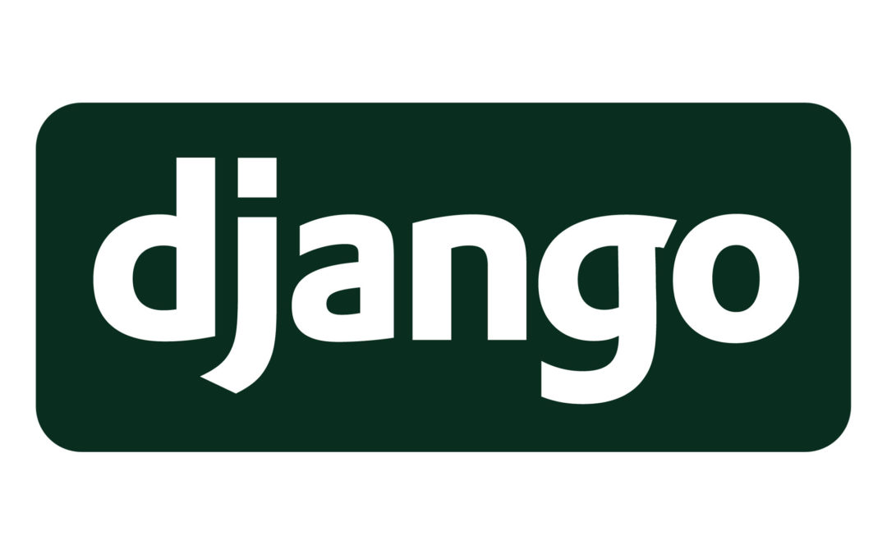
Session Contents
What is Django?
Why Django?
Features of Django
Architecture
MVC
MVT
Django Installation
Project Creation
Project modules

Slide 3
Introduction
What is a Framework?
a collection of tools which we will use to do a complex task.
When coming to developing web pages we have to concentrate on so many things like protocols, sockets, thread management ..etc.. So, generally a web framework contains all the modules we need for developing a web page so that users can focus on the application logic instead of basic routine processes.

Slide 4
Python Frameworks
We have different web frameworks available in python
Django
Flask
Web2Py
Bottle
CherryPy etc,.

Slide 5
Django
Django is a Python Framework designed to support the development of web applications
Named after famous guitarist Django Reinhardt
Created in 2003 open sourced in 2005
Adrian Holovaty, Simon Willison

Slide 6
Features of Django
Free and Open Source
Complete
Secure
Scalable
Maintainable : Do not Repeat Yourself
Portable
Versatile : Used to built any type of website
Content Management systems, social networking, news applications..

Slide 7
Django vs Flask
Property | Django | Flask
Type | Full Stack | Micro Framework
Database | Relational Database | NoSql
Project Size | Large | Small
Project Layout | Conventional | Arbitrary
Performance | Bit low | High

Slide 8
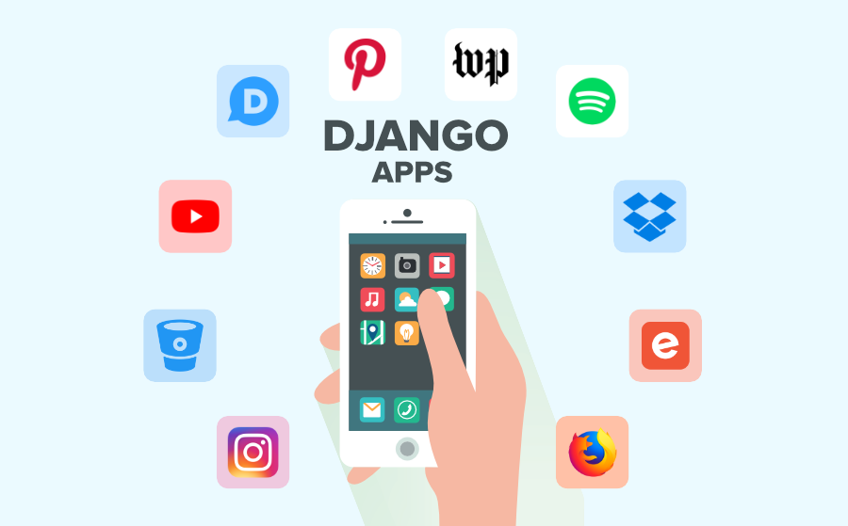
Companies using Django

Slide 9
Web Development Terminology
Browser : A web browser is the software used to access the internet and display web pages.
Protocol : A set of established rules that dictate how to format, transmit and receive data
URL : Unified Resource Locater (protocol://domain/subdirectory?query)
Cache : A temporary storage space for data
Socket : Sockets are commonly used for client and server interaction. The socket on the server process waits for requests from a client
HTTP : html pages
HTTPS : HTTP SECURE
SMTP : MAILS
FTP : FILES

Slide 10
Architecture
Every web application follows a traditional pattern for development of application
MVC : Model – View – Controller (commonly used pattern)
Django follows MVT Pattern
M – Model
V – View
T - Template

Slide 11
Django Installation
We can install Django from pip
‘pip install django’
To check the Django Version
‘django-admin version’
Download Any Editor
Sublime
PyCharm
Visual Studio Code

Slide 12
Project Creation
‘django-admin startproject projectName’
Project modules
Manage.py
Project Package
Init.py
Settings.py
Urls.py
Asgi.py
Wsgi.py

Slide 13
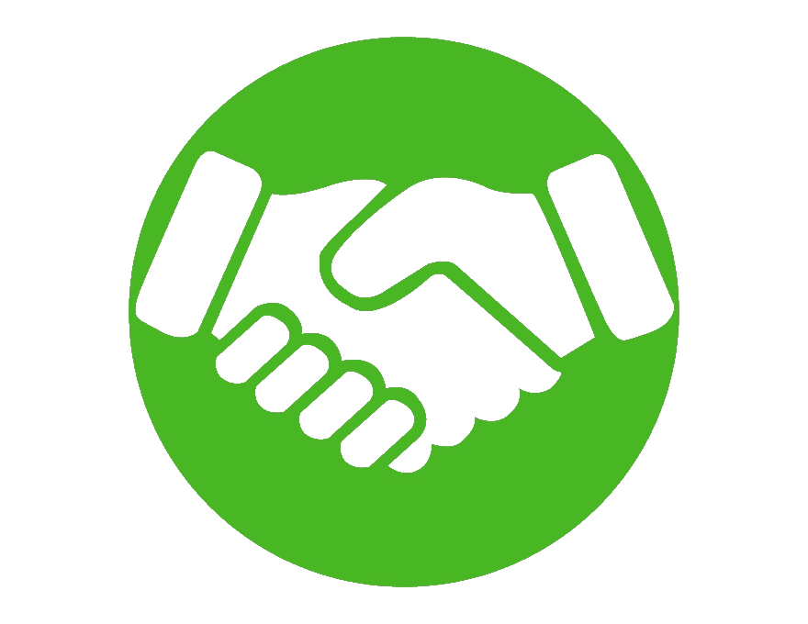
APSSDC
Andhra Pradesh State Skill Development Corporation
(Department of Skills Development and Training, Govt of Andhra Pradesh)
THANK YOU

